Slide 1
Deep Fake Detection
Srivarshini
B.E – Cse

Slide 2
Agenda
PROBLEM STATEMENT
PROJECT OVERVIEW
END USERS
SOLUTION
SPECIAL CONTENT
MODELLING
RESULTS

Slide 3
Problem statement
Develop a deepfake detection system capable of accurately identifying manipulated videos and images.
The system should be able to distinguish between genuine and altered media content, including facial expressions, voice patterns, and subtle visual cues.
The solution should be robust against various deepfake generation techniques and capable of real-time processing for timely intervention.

Slide 4
project overview
Creating a deepfake detection system employing Convolutional Neural Networks (CNN) to discern manipulated media content from authentic sources.
Training the model on diverse datasets, evaluating its accuracy, and potentially integrating real-time processing capabilities.
The project aims to combat the proliferation of deceptive content and safeguard the integrity of digital media.

Slide 5
End users
Social media platforms
News organizations
Law enforcement agencies
Government agencies
Corporate entities
Educational institutions
Individuals

Slide 6
solution
A deepfake detection solution employs advanced machine learning techniques like Convolutional Neural Networks (CNNs) to analyze media content for signs of manipulation.
By training on diverse datasets, extracting relevant features, and evaluating against performance metrics, the model can identify various manipulation techniques.
Integration into software enables real-time detection, with continuous refinement to address emerging threats.
Additionally, robustness testing ensures resilience against adversarial attacks, enhancing the solution's effectiveness in combating deepfake proliferation.

Slide 7
Special content
Data collection involves diverse datasets and accurate annotations. Training models involves selecting architectures, optimizing parameters, and evaluating performance.
Robustness techniques defend against adversarial attacks.
Real-world applications span social media, news, and law enforcement, with ethical considerations guiding future research.

Slide 8
Modeling
Convolutional Neural Networks (CNNs)
Recurrent Neural Networks (RNNs)
Hybrid Models
Generative Models
Variational Autoencoders (VAEs)
Generative Adversarial Networks (GANs)
Transfer Learning
Ensemble Methods

Slide 9
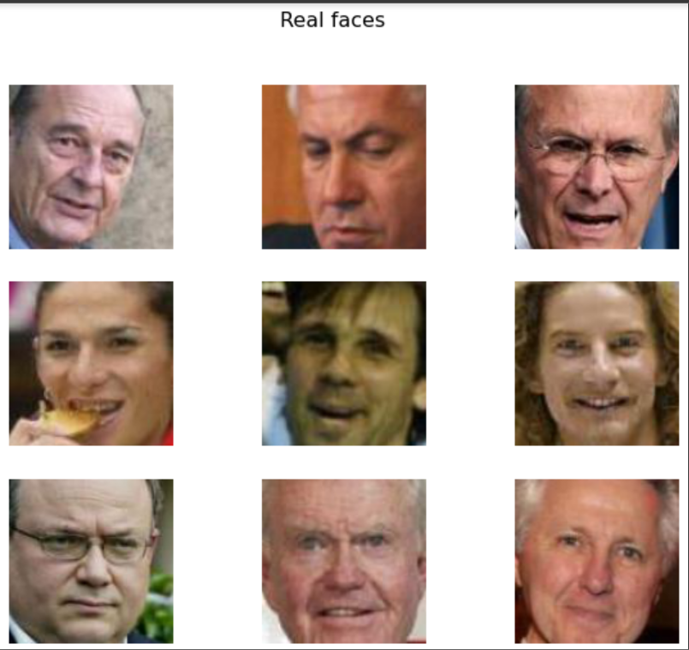
Results

Slide 10
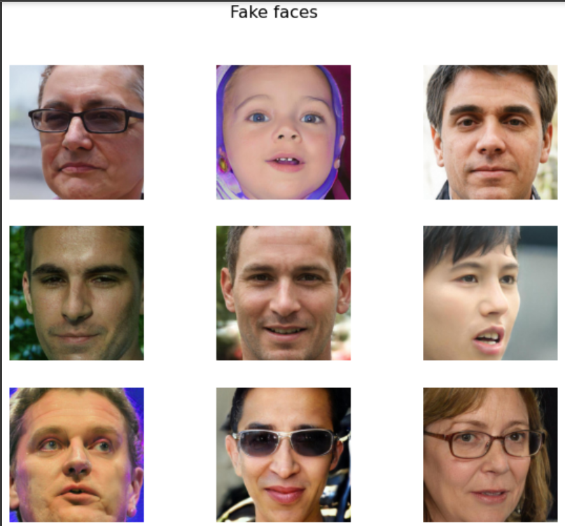

Slide 11
THANK YOU

